Slide 1
UPPMS
University Project Portfolio Management System
Students
Baraa Abdullah
Sohayb Sabboura
Obada Kahwajy
Supervised by
Anas Abdulaziz
Graduation Project Presentation · Syrian Private University

Slide 2
Agenda
• 1. Problem Statement
• 2. How Our System Solves the Problem
• 3. System Advantages
• 4. What Was Implemented Before vs Now
• 5. Methodology (Gantt, Use Case, Activity, Sequence)
• 6. Tools Used
• 7. Live Demo
UPPMS · Graduation Project Presentation
2 / 16

Slide 3
1. Problem Statement
• Graduation projects are managed with scattered tools (chat, sheets, email).
• No reliable isolation when multiple universities share one platform.
• Open registration allows unverified accounts into the academic workspace.
• Choosing a project idea and breaking it into tasks is slow and unstructured.
• Defense scheduling is manual, conflict-prone, and hard to optimize.
• Academic progression across stages lacks enforced prerequisites.
• Supervisors and admins lack a single source of truth for proposals, progress, and defenses.
UPPMS · Graduation Project Presentation
3 / 16

Slide 4
2. How Our System Solves the Problem
Secure Access
Multi-tenant isolation by university
XML-based authorized registration
Role-based access (RBAC)
Smart Project Flow
AI project ideation (Gemini)
Supervisor proposal approval
AI task breakdown + GitHub link
Academic Control
Configurable academic tracks
Prerequisite stage unlocking
Defense result updates progress
Intelligent Defense Scheduling
Genetic algorithm generates conflict-aware schedules
Rooms, availability, committees, and constraints
Admin reviews candidates and approves the final plan
One Platform
Students, supervisors, university & platform admins
Projects, tasks, notifications, dashboards together
Spec-driven delivery for reliable increments
UPPMS · Graduation Project Presentation
4 / 16

Slide 5
3. System Advantages
• University-level data isolation with shared SaaS deployment
• Verified onboarding via official XML records (student: email + number, supervisor: email)
• End-to-end lifecycle: idea → proposal → project → tasks → defense
• AI assistance for ideation and task decomposition
• Optimized defense scheduling with hard and soft constraints
• Manual committees when needed; genetic search when scale is high
• Academic tracks enforce sequential progress and prevent skipping stages
• Modern React SPA + Laravel API — maintainable and extensible
UPPMS · Graduation Project Presentation
5 / 16

Slide 6
4. Implemented Before vs Now
Previously Implemented
• Multi-tenancy foundation (universities)
• RBAC & account approval workflow
• UI workspace isolation
• Core projects, tasks, comments
• Invitations & GitHub linking
• Notifications & dashboards
• AI project ideation
• AI task breakdown + flexible UI
Implemented Now (Recent Phases)
• Scheduling infrastructure (rooms, availability, stages)
• Genetic Algorithm scheduling engine
• Scheduling API & admin dashboard
• XML registration & data matching
• Project proposals & supervisor approval
• Manual defense committee management
• Academic tracks & sequential progress
• Full documentation & design diagrams
UPPMS · Graduation Project Presentation
6 / 16

Slide 7
5. Methodology
• Spec-Driven Development (Spec Kit): constitution → specify → plan → tasks → implement
• Incremental phases with testable deliverables after each sprint
• UML artifacts for analysis and design:
• – Gantt Chart for planning and milestones
• – Use Case Diagram for actor–system interactions
• – Activity Diagram for key business workflows
• – Sequence Diagram for controller/service collaborations
• Layered Client–Server SPA architecture with multi-tenant isolation
UPPMS · Graduation Project Presentation
7 / 16

Slide 8
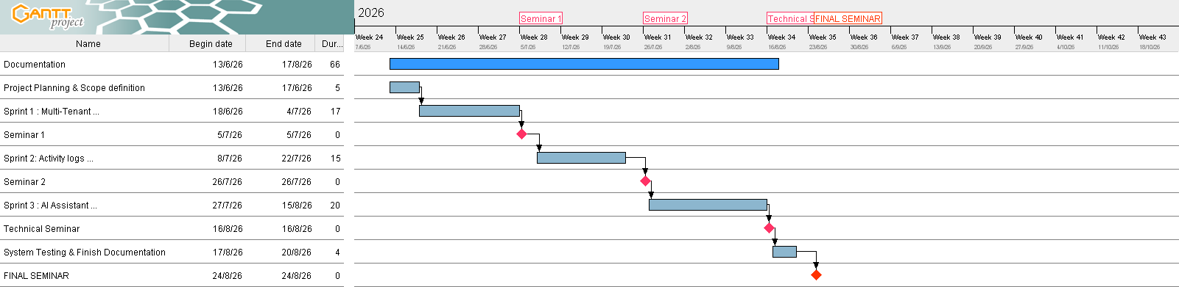
5.1 Gantt Chart
UPPMS · Graduation Project Presentation
8 / 16

Slide 9
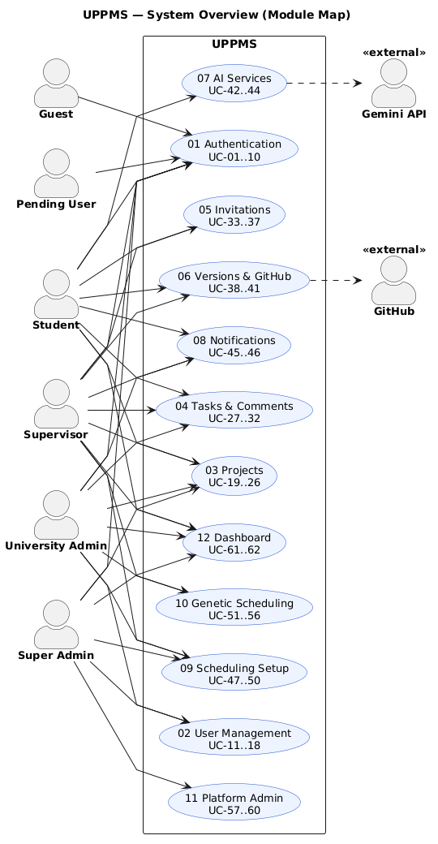
5.2 Use Case Diagram
UPPMS · Graduation Project Presentation
9 / 16

Slide 10
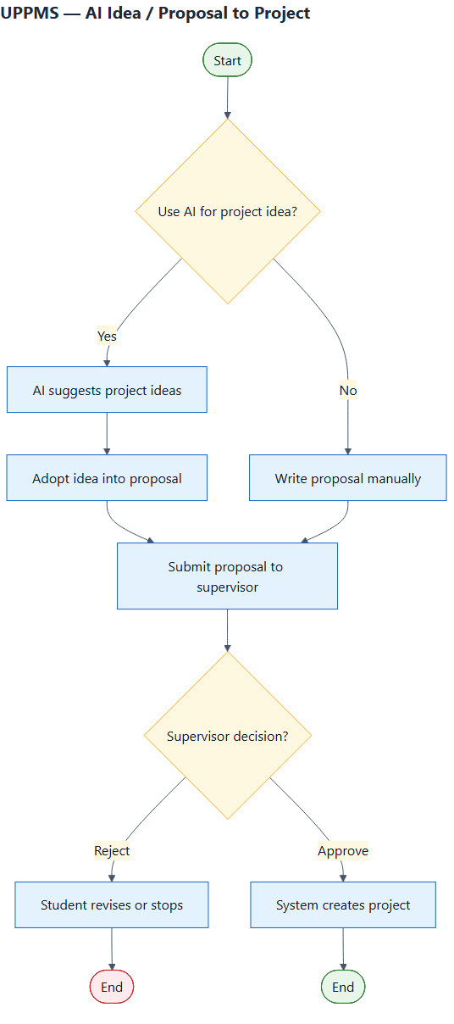
5.3 Activity Diagram
UPPMS · Graduation Project Presentation
10 / 16

Slide 11
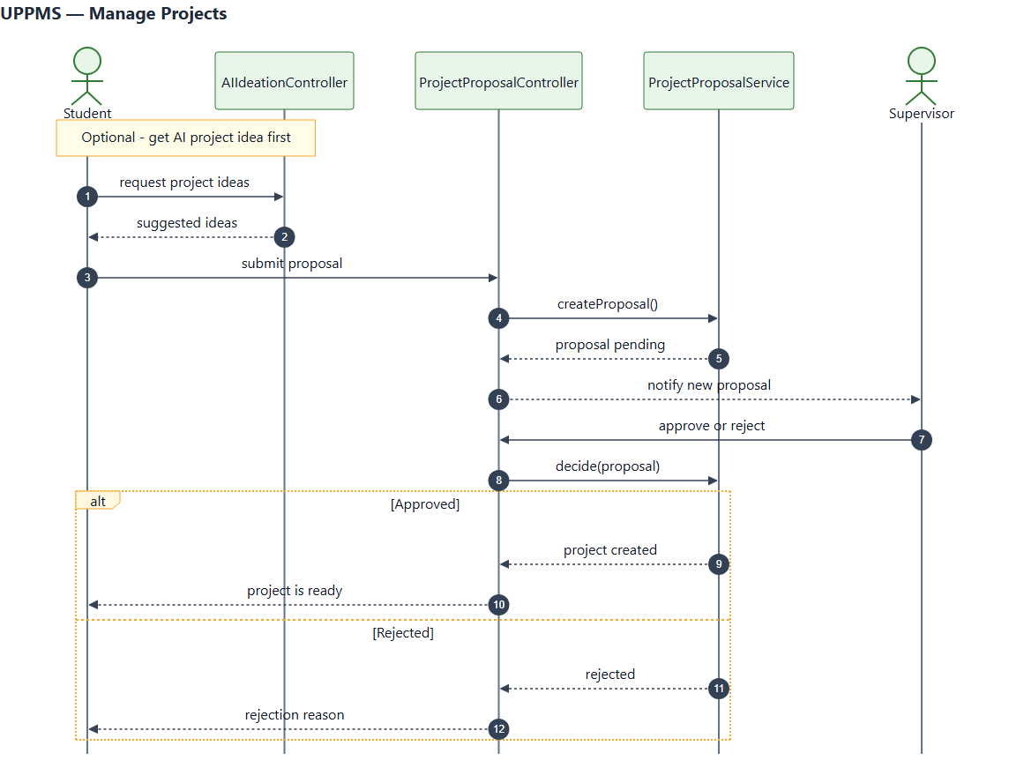
5.4 Sequence Diagram
UPPMS · Graduation Project Presentation
11 / 16

Slide 12
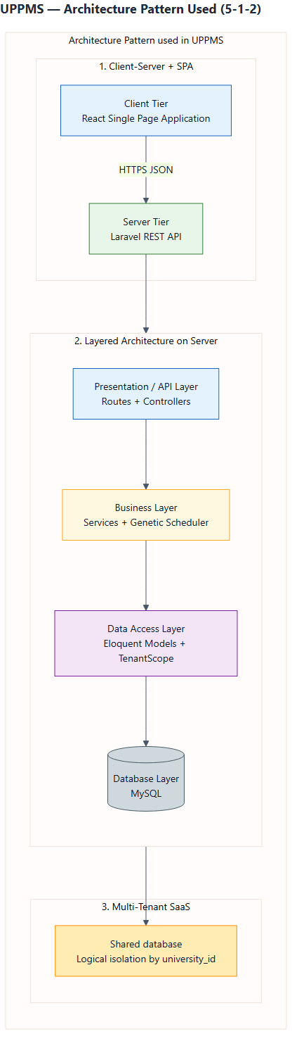
5.5 Architecture Overview
UPPMS · Graduation Project Presentation
12 / 16

Slide 13
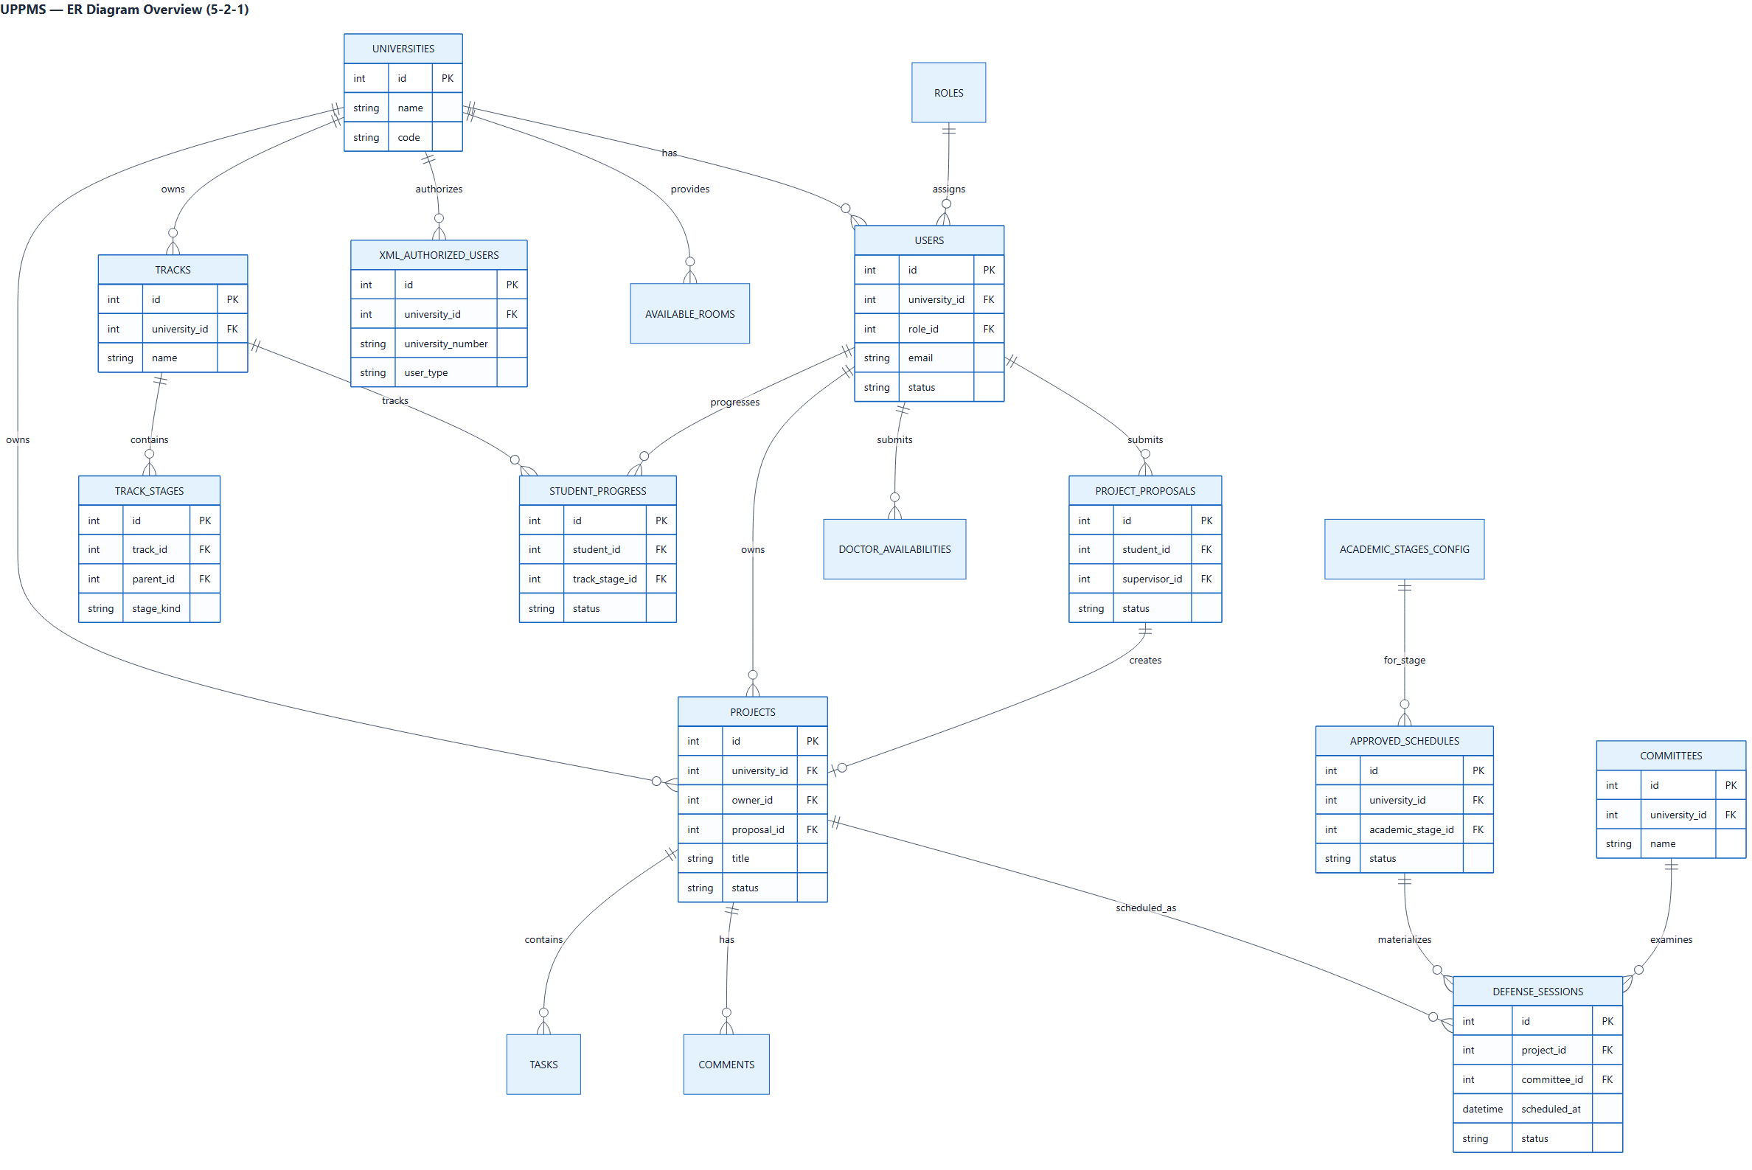
5.6 Data Model Overview (ERD)
UPPMS · Graduation Project Presentation
13 / 16

Slide 14
6. Tools Used
Backend
Laravel (PHP)
Eloquent ORM
MySQL
REST API + Sanctum
Frontend
React (Vite)
Material UI
React Router
i18n (EN / AR)
AI & Algorithms
Google Gemini API
Genetic Algorithm
Constraint fitness
Engineering Process
Spec Kit (spec-driven development)
PHPUnit feature/unit tests
Git / GitHub
Design & Planning
PlantUML / Mermaid diagrams
GanttProject
Chapter 5 design docs
UPPMS · Graduation Project Presentation
14 / 16

Slide 15
7. Live Demo

Slide 16
Thank You
Questions & Discussion
Baraa Abdullah · Sohayb Sabboura · Obada Kahwajy
Supervisor: Anas Abdulaziz

